Slide 2
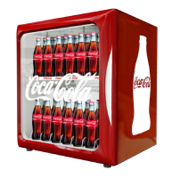
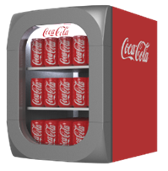
Minicube vs Icool 40
Minicube
Icool 40
Test in GB
665 X 612 X 505
No. of shelves: 2
Max. capacity cans: 84
Max.capacity PET: -
Facings per shelf: 6
Noise (dB) : 54,3
Prijs: € ?,- afhankelijk van aantallen
Test in BLX
589 x 435 x 470
No. of shelves: 2 (+bodum)
Max. capacity cans: 45
Max. capacity PET: 20
Facing per shelf: 5
Noise (dB): 53
Prijs: € ,- afhankelijk van aantallen

Slide 3
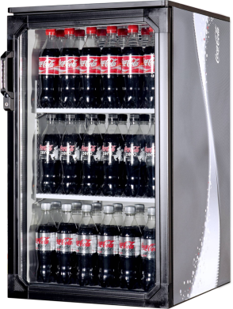
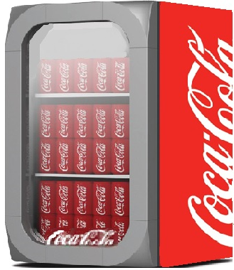
Super 5 vs Icool 150
Super 5
Icool 150
Bovenkant
890 X 500 X 615
No. of shelves: 2 (+ bodum)
Max. capacity cans: 162
Max.capacity PET: 90
Facings per shelf: 6
Noise (dB) : 53
Prijs: € 400,-
876 x 500 x 614
No. of shelves: 2 (+bodum)
Max. capacity cans: 168
Max. capacity PET: 90
Facing per shelf: 6
Noise (dB): 53
Prijs: € 365,-

Slide 4
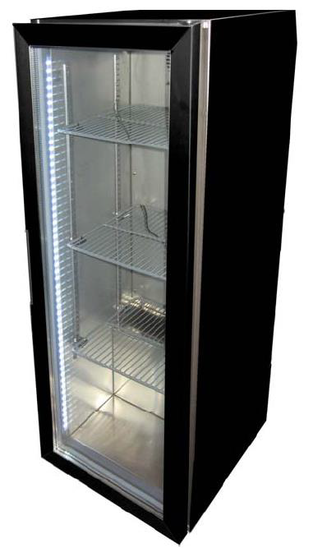
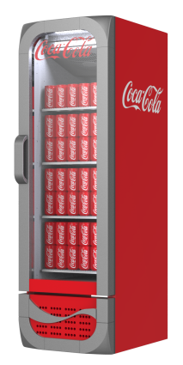
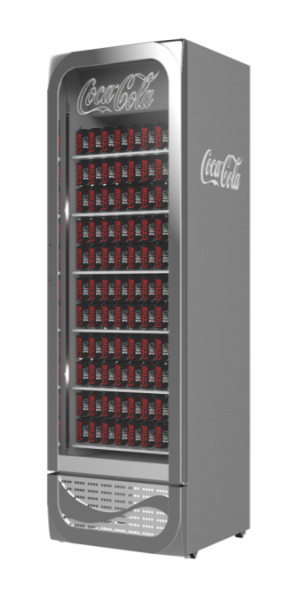
Medium coolers
Silent cooler:
Icool 300:
= Available
Cost: € 400,-
= New silent cooler?
Cost: € 426,-

Slide 5
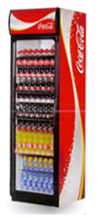
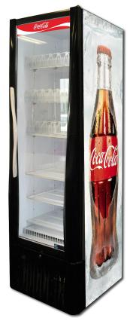
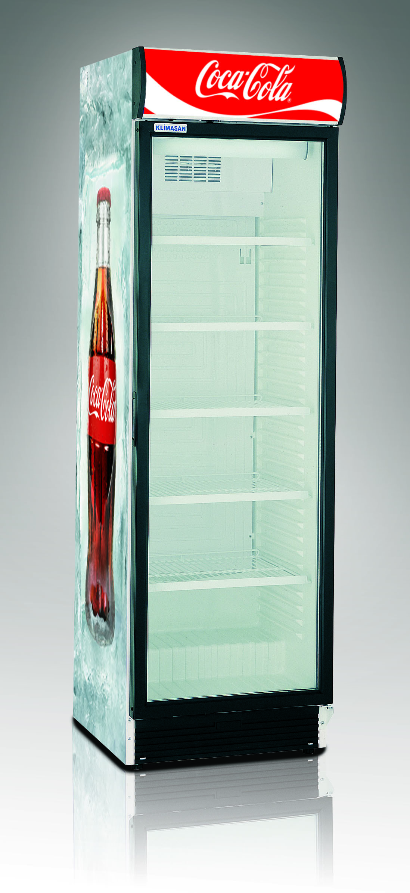
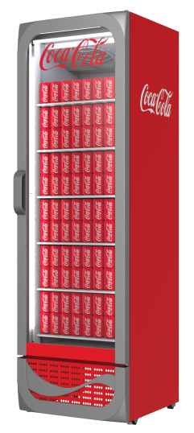
Single Door coolers
Super 7
Tot 2009
Tower
2009 tot 2013
Klimasan
2013 tot heden
Icool 500
Start Q2→ 2015
H1995 X W595 X D685
No. of shelves: 5+ bodum
Max. capacity cans: 500
Max.capacity PET: 250
Facings per shelf: 7
Supplier: Frigiglass
Prijs: € 992
Alleen refurb
2105 X 600 X 745
No. of shelves: 6
Max. capacity cans: 390
Max.capacity PET: 243
Facings per shelf: 7
Supplier: ISA
Prijs: € 914
Alleen refurb
1985 X 595 X 640
No. of shelves: 5+ bodum
Max. capacity cans: 399
Max.capacity PET: 224
Facings per shelf: 7
Supplier: Klimasan
Prijs: € 496
Nieuw en refurb
2140 x 653 x 667
No. of shelves: 5+Bodum
Max. capacity cans: 528
Max. capacity PET: 240
Facing per shelf: 8
Supplier: Frigoglass
Prijs: € 710,-
Alleen nieuw

Slide 6
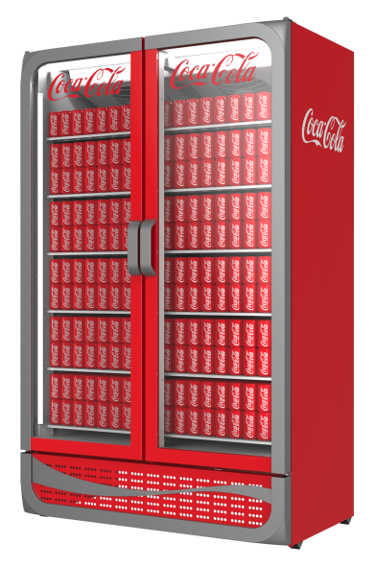
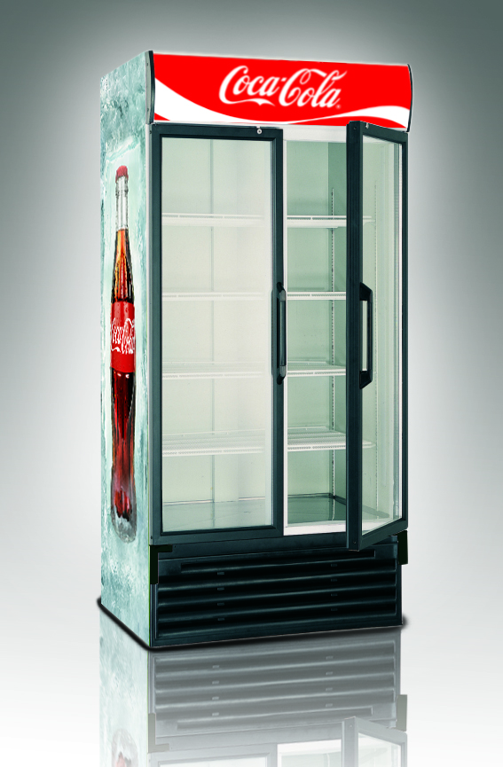
Double Door coolers
Klimasan
2012 tot heden
Icool 1300
Start Q2→ 2015
2010 X 880 X 750
No. of shelves: 5+ bodum
Max. capacity cans: 720
Max.capacity PET: 375
Facings per shelf: 7
Supplier: Klimasan
Prijs: € 1.113
Alleen refurb
2140 x 1310 x 745 (let op Icool is 43cm breder)
No. of shelves: 5+ Bodum
Max. capacity cans: 1584
Max. capacity PET: 720
Facing per shelf: 8
Supplier: Frigoglass
Prijs: € 1.179,-
Alleen new

